Slide 1
Church Council Chairperson Training
Enabling Quality Leadership for the Local Church
Basic Church Administration

Slide 2
Humble Service in the Body of Christ – Romans 12:4-8
4 For just as each of us has one body with many members, and these members do not all have the same function, 5 so in Christ we, though many, form one body, and each member belongs to all the others. 6 We have different gifts, according to the grace given to each of us. If your gift is prophesying, then prophesy in accordance with your[a] faith; 7 if it is serving, then serve; if it is teaching, then teach; 8 if it is to encourage, then give encouragement; if it is giving, then give generously; if it is to lead, do it diligently; if it is to show mercy, do it cheerfully.

Slide 3


Function of the Church Council
Paragraph 252 in the Book of Discipline
Plan, implement program of Nurture, Outreach, and Witness ministry.
Provide administration of the life of church.
Annually envision, plan, implement, and evaluate the mission and ministry of the local church.
Under the direction of the Charge Conference.
Envision, plan, implement, and evaluate effective ministry!

Slide 4
Envision
Where is God leading us or calling us to go.
Best done as a retreat.
Congregational specialist can help.
Envision, plan, implement, and evaluate effective ministry!

Slide 5
Planning
Long-term
Short-term
Seasonal
Event
Envision, plan, implement, and evaluate effective ministry!

Slide 6
Implement
Who’s responsible
What resources are needed?
When, where, how?
Envision, plan, implement, and evaluate effective ministry!

Slide 7
Evaluate
Did it meet the purpose for which intended?
What went right?
What can be improved?
Do we do it again?
Envision, plan, implement, and evaluate effective ministry!

Slide 8
Other Duties of the Council
Review
Review the membership of the local church.
Fill
Fill interim vacancies of officers between charge conferences.
Establish
Establish the church budget on recommendation of the Finance Committee and ensure adequate provision for the needs of the church.
Forward
Review
Review housing recommendations from the SPRC for the pastor/s.
Forward to Charge Conference the salary and benefits for the pastor and lay staff on recommendation from SPRC.

Slide 9

Council Membership
Chairperson
Lay Leader
Chairperson/representative from SPRC
Chairperson/representative from Finance Committee
Chairperson/representative from Board of Trustees
Church Treasurer
Lay Member to Annual Conference

Slide 10
Council Membership
UMW President or representative.
UMM President or representative.
UMY President or representative.
Young Adult Representative.
The Pastor/s.
Representatives from the Nurture, Outreach, Nurture ministries as determined by Charge Conference.

Slide 11
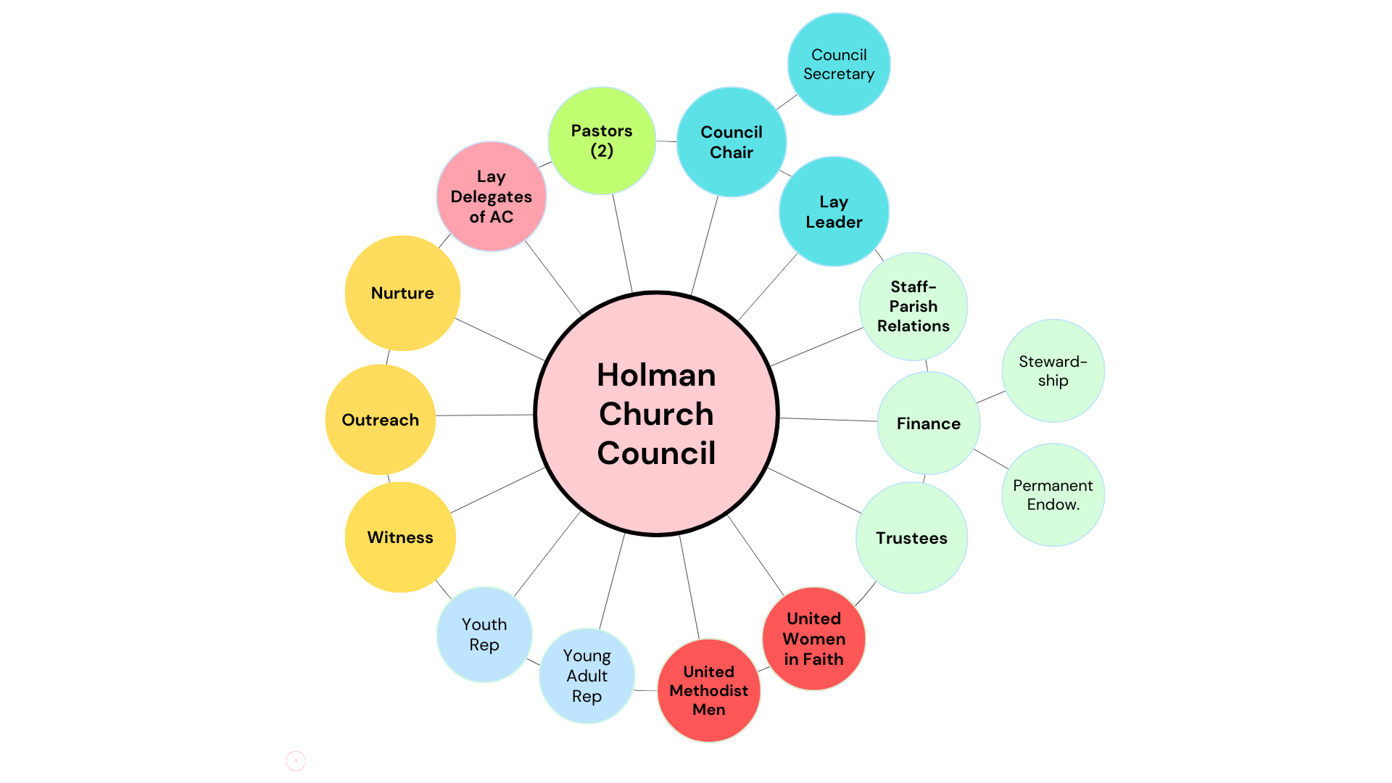

Slide 12
Nurture
Worship
Education
Christian Formation
Membership Care
Small Groups
Stewardship

Slide 13
Outreach
Missions
Advocacy
Justice
Compassion

Slide 14
Witness
Evangelism
Communications
Lay Servant Ministries

Slide 15
Five Purposes of Church from Acts 2
Worship
Education
Fellowship
Mission
Evangelism

Slide 16

Life Cycle of Discipleship

Slide 17
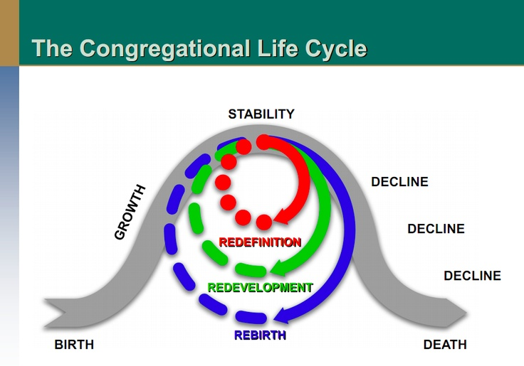
Life Cycle of a Church

Slide 18
Relationship of Discipleship to
Life Cycle of a Church

Slide 19
Role of the Chairperson
Duties found at Paragraph 253.3
Lead Council in fulfilling its responsibilities
Prepare and communicate the agenda in consultation with the Pastor, Lay Leader and other persons.
Assign responsibility for implementing actions taken by Council

Slide 20
Role of the Chairperson
Coordinate activities of Council.
Provide initiative and leadership as it plans, establishes objectives and goals, and evaluating.
Participate in leadership training opportunities presented by district or conference.

Slide 21

Meetings Requirements
Should meet at least quarterly, more often as needed.
Can be called by chairperson or pastor.
Quorum – All members present constitute a quorum.
Agenda should give priority to ministries of nurture, outreach, and witness ministries.
Administrative and support of ministries next.
Recommended to use Consensus/discernment model of decision making.

Slide 22
Consensus/
Discernment Model
Purpose is to promote unanimity
Each person speaks once – then listens to all the others
Discover where people are
  1 – agree and will support
  2 – agree but have reservations
  3 – disagree but will support
  4 – disagree and cannot support
Anyone in a 2,3,or 4 – stop and allow to express concerns.
Work out details to address concerns

Slide 23
Meetings Best Practices
If not a regularly scheduled meeting, adequate communication of called meeting.
Publish agenda before meeting.
Provide minutes of the previous meeting to remind members.
Begin with devotional and/or prayer.
Approve the minutes from previous meeting.
Approve the agenda for current meeting.
Work with action/decision items first.
Receive reports, in writing saves time.

Slide 24

Minutes
1. Date and Time of Meeting
2. Who Was Present
3. Previous minutes approved
4. Agenda approved
5. Deal with Action Items first
  VBS approved for June 13
    Education Chairperson responsibility
    Report back on planning
  6. Reports for Information (preferably in writing.

Slide 25

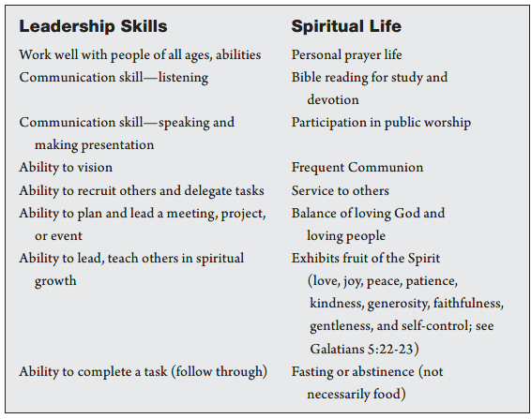



Qualities of a Council Chairperson

Slide 26



Resources for Church Councils

Slide 27
Internet Resources
South Carolina Annual Conference – www.umcsc.org
General Commission on Finance and Administration – www.GCFA.org.
Discipleship Ministries - www.umcdiscipleship.org
Smart Church Management - Smart Church Management -
Basic Church Administration – www.church-admin.org.

Slide 28
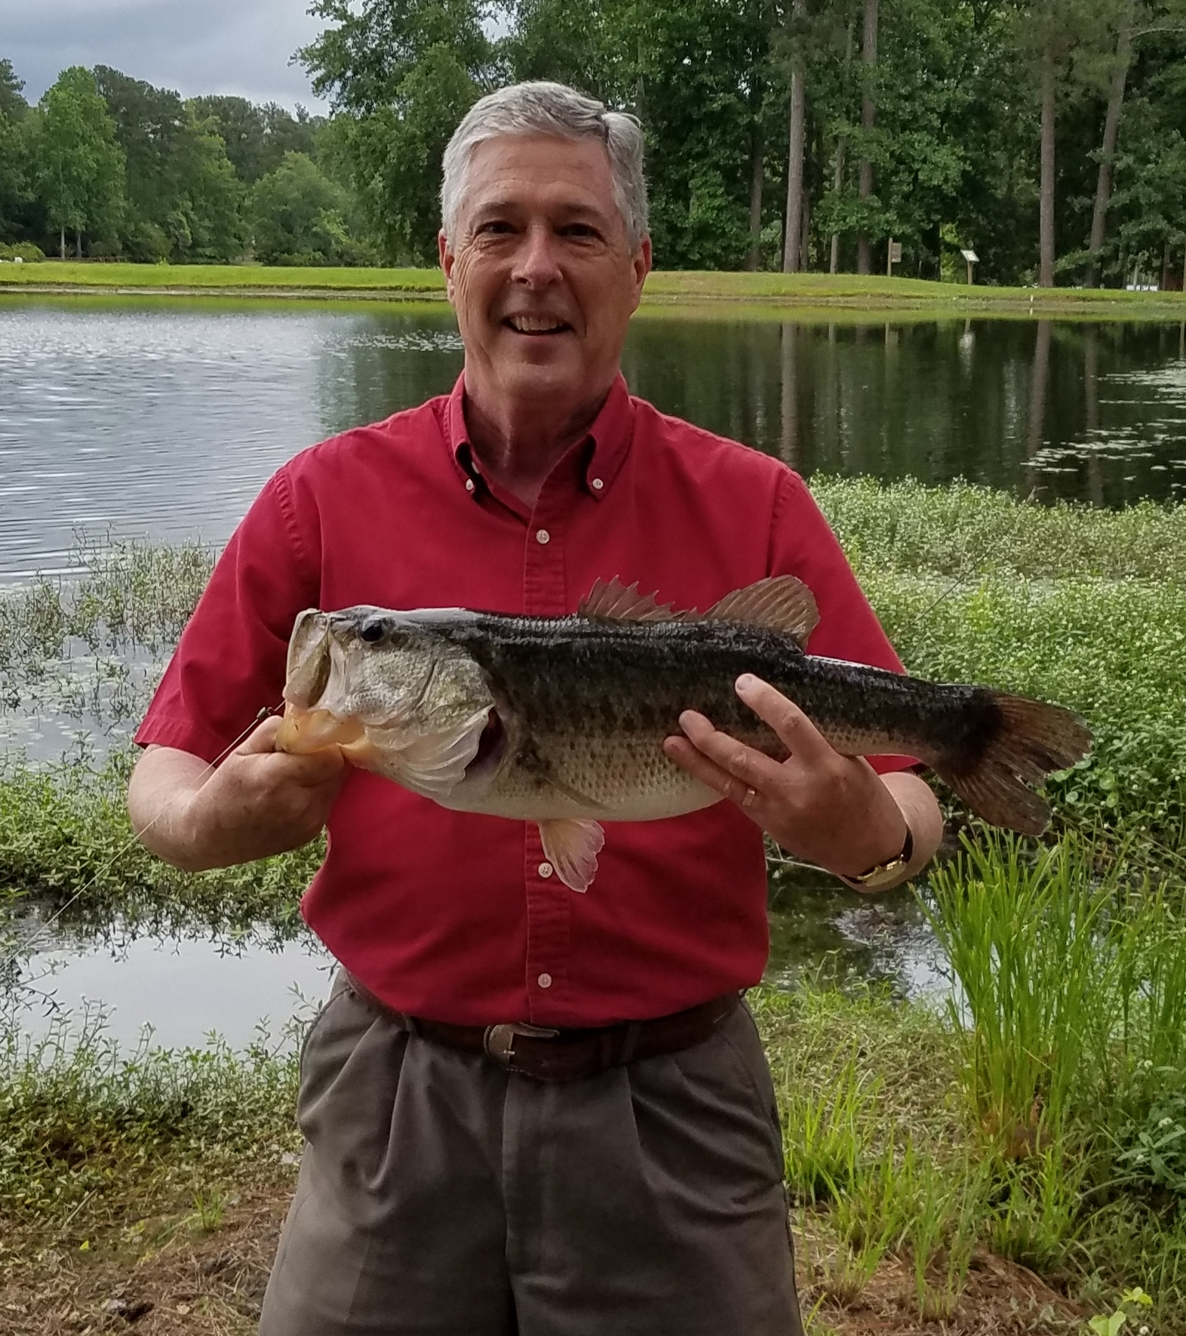
Your Presenter
Rev. Robert Cox
rlcox@umcsc.org
864-554-2008
(M-F, 9am-9pm)
www.church-admin.org

