Slide 1
Basic Church Administration
Keeping Records and Maintaining Legal Requirements

Slide 2
Acts 2:41-42
⁴¹ So those who welcomed his message were baptized, and that day about three thousand persons were added. ⁴² They devoted themselves to the apostles’ teaching and fellowship, to the breaking of bread and the prayers.

Slide 3
Basic Church Administration
1 Corinthians 12:27-28
New International Version 1984 (NIV1984)
²⁷ Now you are the body of Christ, and each one of you is a part of it. ²⁸ And in the church God has appointed first of all apostles, second prophets, third teachers, then workers of miracles, also those having gifts of healing, those able to help others, those with gifts of administration, and those speaking in different kinds of tongues.

Slide 4
Who Is Ultimately Responsible?
Pastor
  Discipline para. 340 – Duties of the pastor
    (1) To be the administrative officer of the local church and to assure that the organizational concerns of the congregation are adequately provided for.
    (2) To administer the temporal affairs of the church in their appointment, the annual conference, and the general church.

Slide 5
Who Is Ultimately Responsible?
Pastor
  (2)(a) To administer the provisions of the Discipline.
  (2)(f) To care for all church records and local church financial obligations, and certify the accuracy of all financial, membership, and any other reports submitted by the local church to the annual conference for use in apportioning costs back to the church.

Slide 6
Sources for Records Requirements
Discipline
  Membership
  Giving
  Financial
  Personnel
  Legal
Governmental
  Giving
  Financial
  Personnel
  Legal

Slide 7
Membership
Keeping Proper records up-to-date

Slide 8
Membership
Types of Members
  Baptized
  Professing
  Associate
  Affiliate
  Constituent
  Status of Members
    Active
    Inactive
    Homebound
    Institutionalized
    Military
    Other

Slide 9
Membership
Ways to join
  Baptism
  Profession of faith
  Reaffirmation of faith
  Transfer from Another UMC
  Transfer from Another Denomination

Slide 10
Membership
Ways to Leave
  Transfer to Another UMC
  Transfer to Another Denomination
  Withdraw
  Expulsion – guilty of chargeable of offense
  Removed by Charge Conference
  Death

Slide 11
Membership
Records Required
  Permanent Church Register (Chronological Roll)
  Record of Faith Journey
  Professing members removed by charge conference
  Constituency Roll
  Affiliate/Associate membership

Slide 12
Membership
Supplemental Records recommended.
  Record of Baptisms
  Family/Household Roll
  Record of Marriages
  Record of Deaths
  Historical Record
  Pastor History

Slide 13
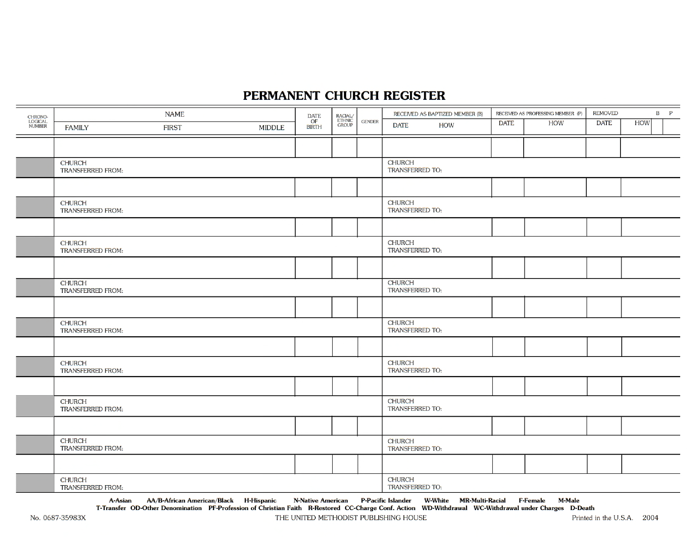
Membership

Slide 14
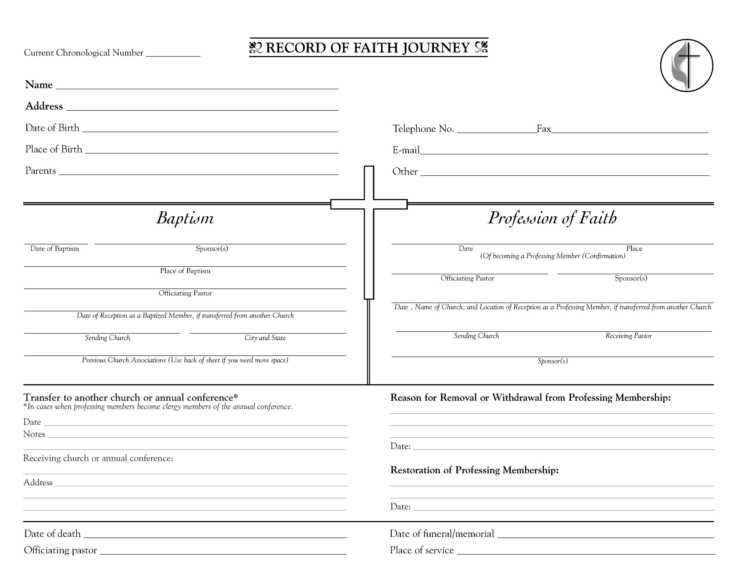

Slide 15
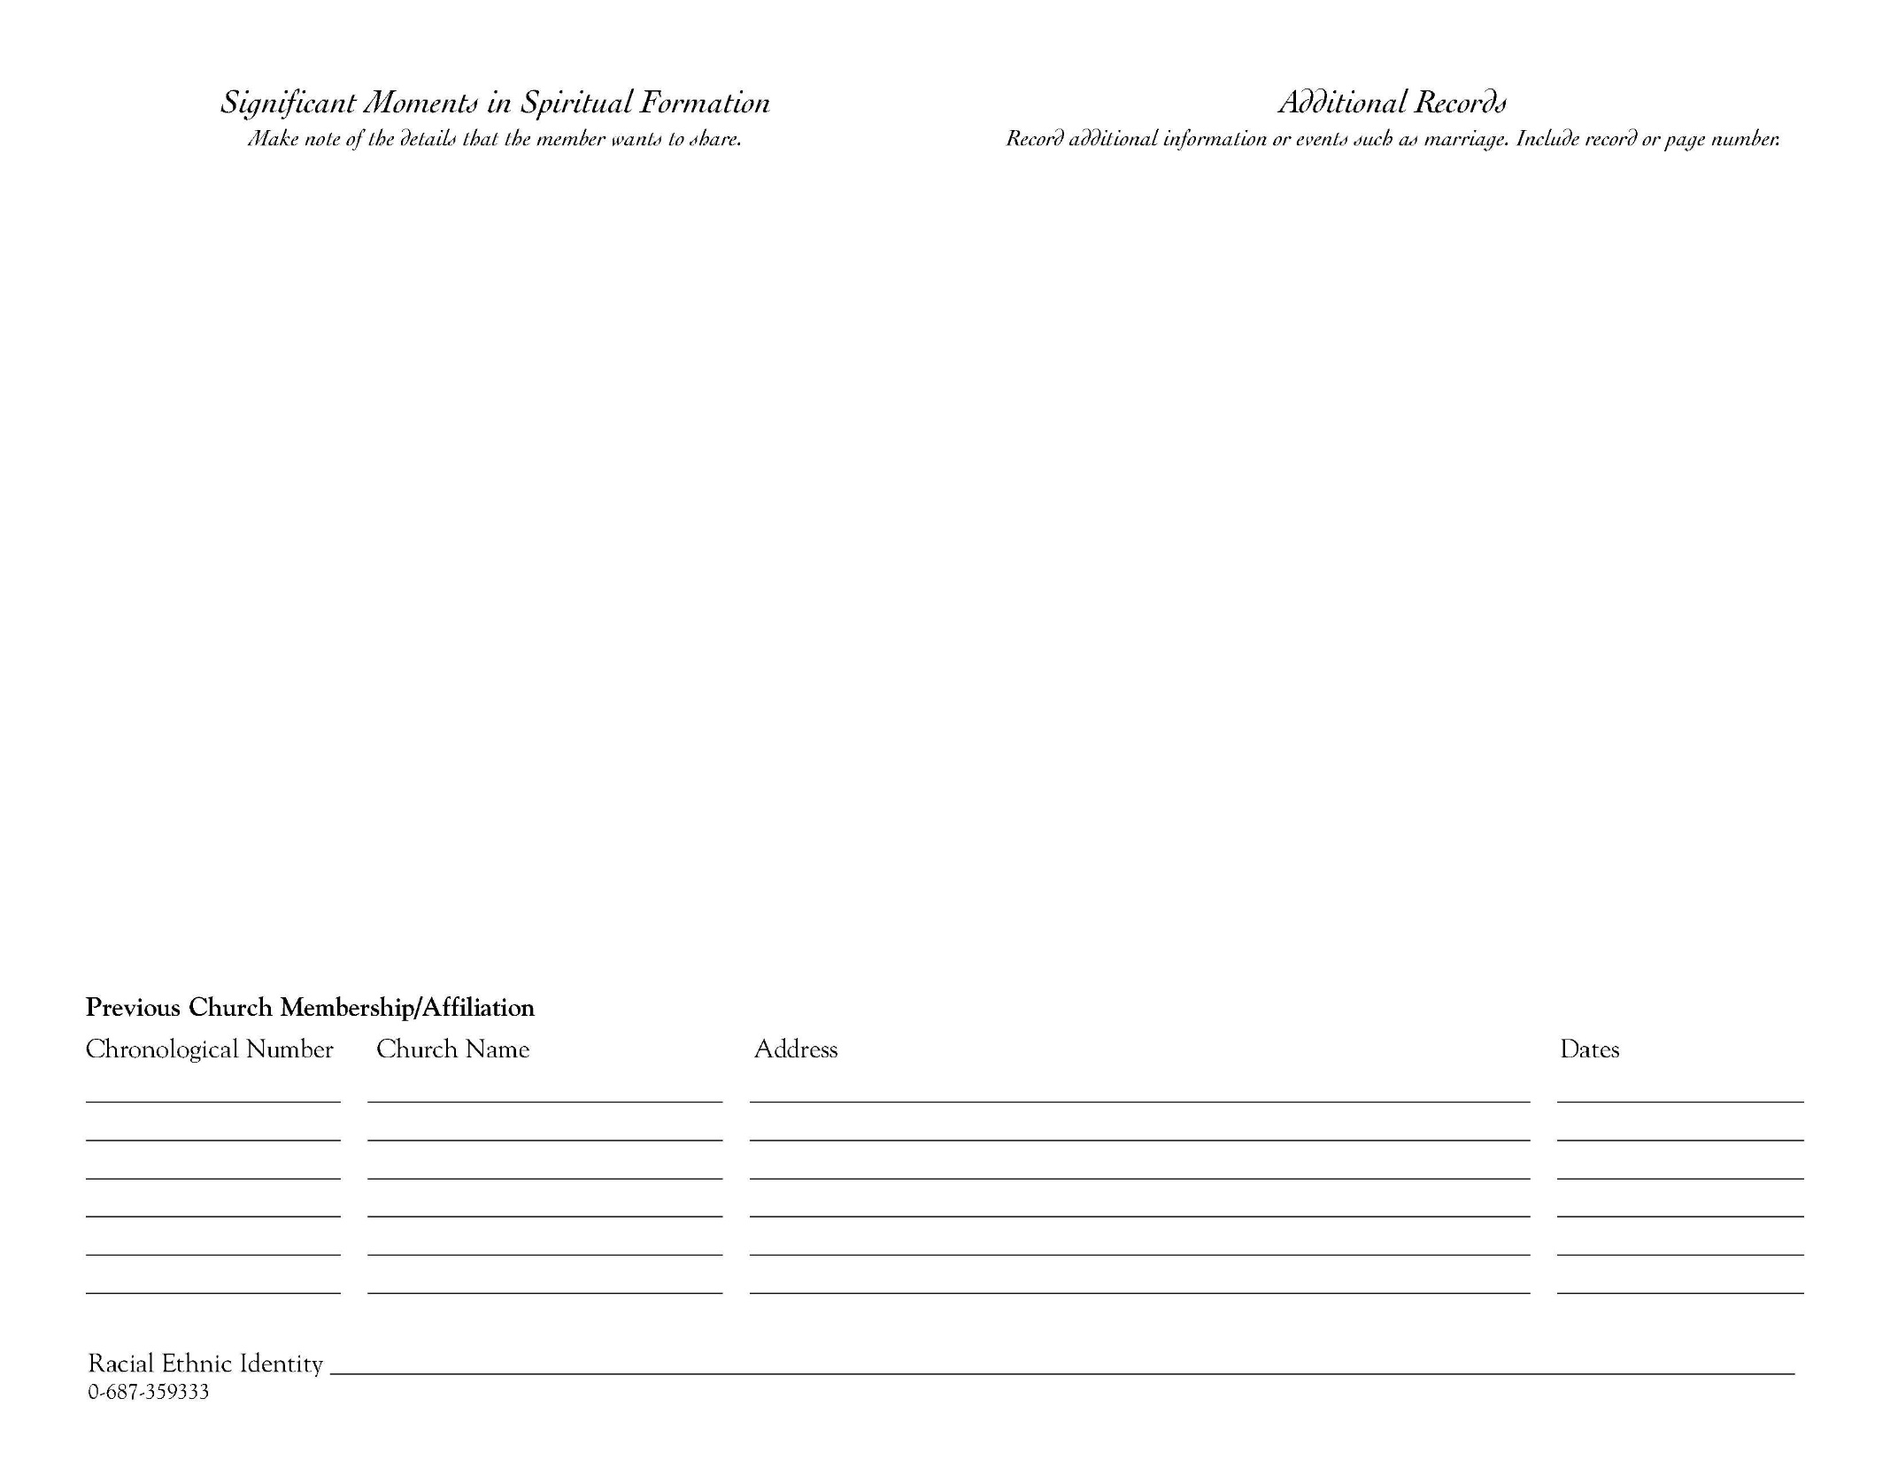

Slide 16
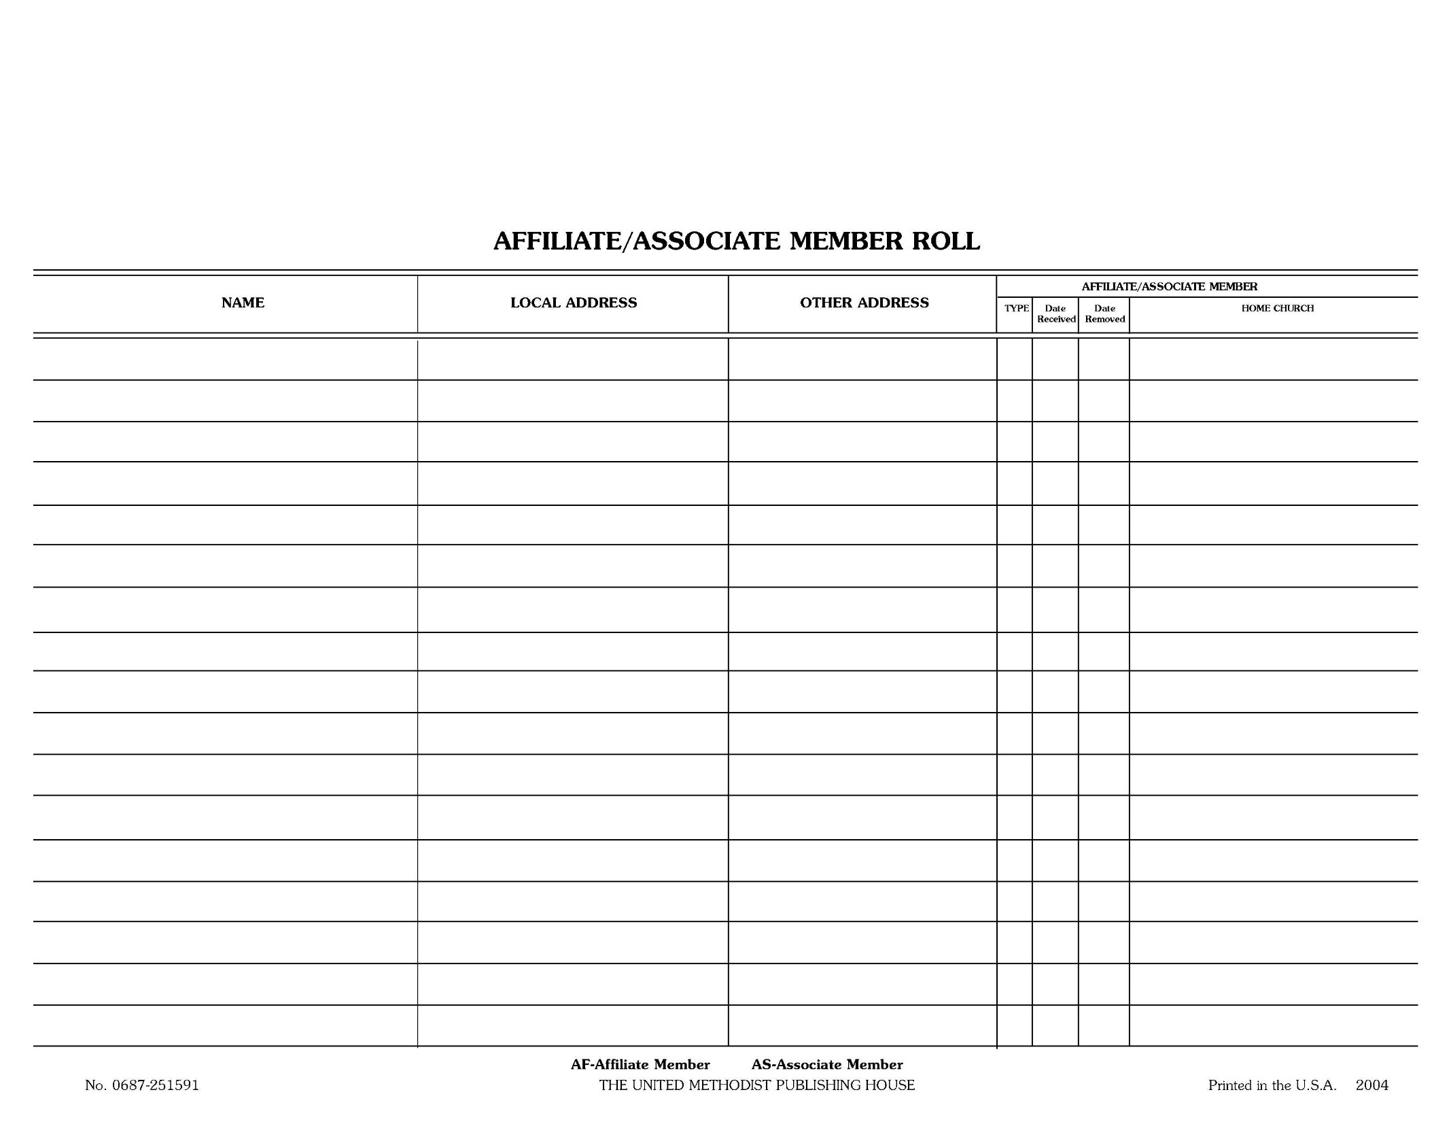

Slide 17
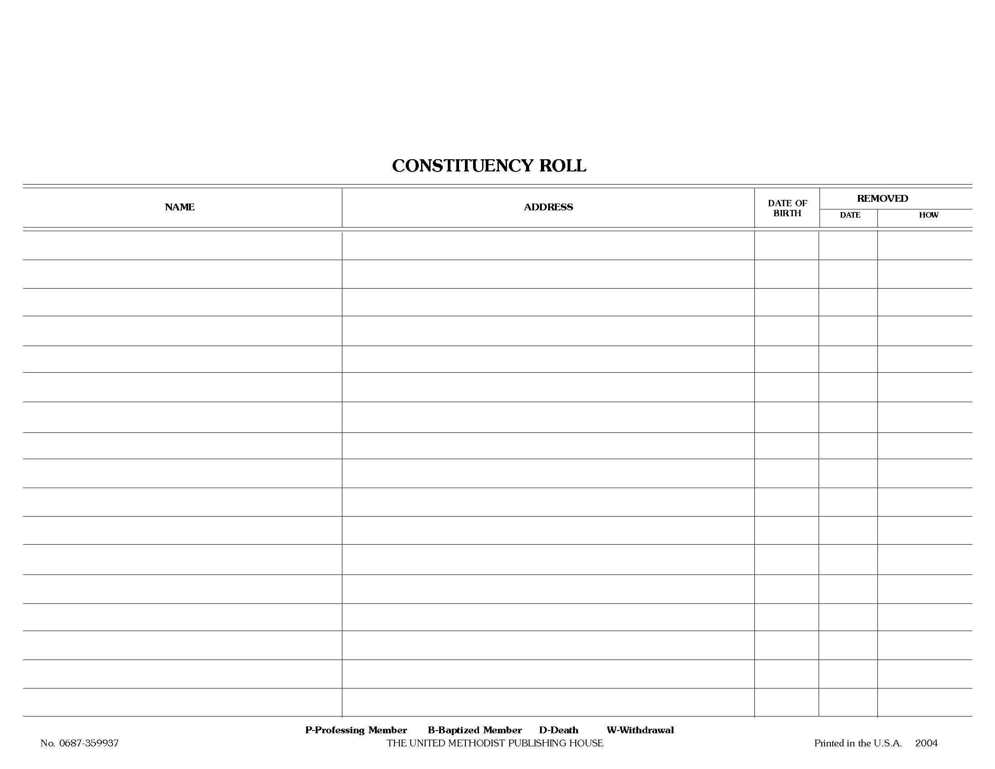

Slide 18
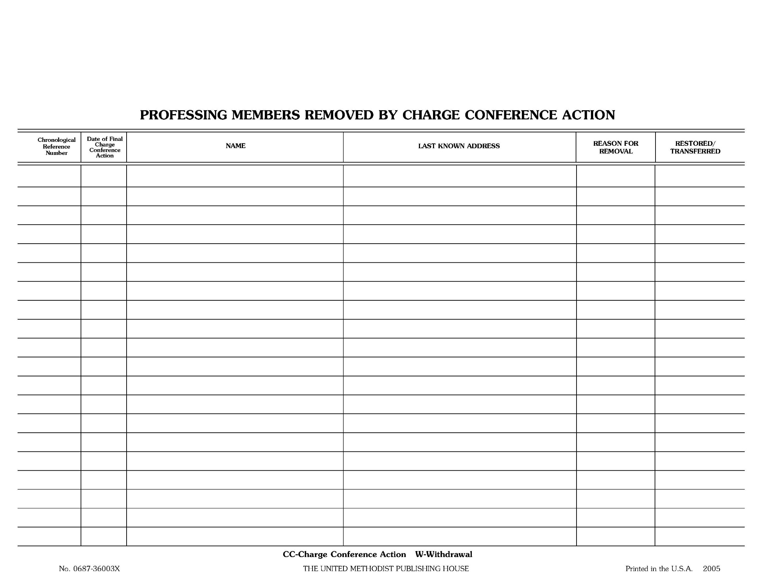

Slide 19
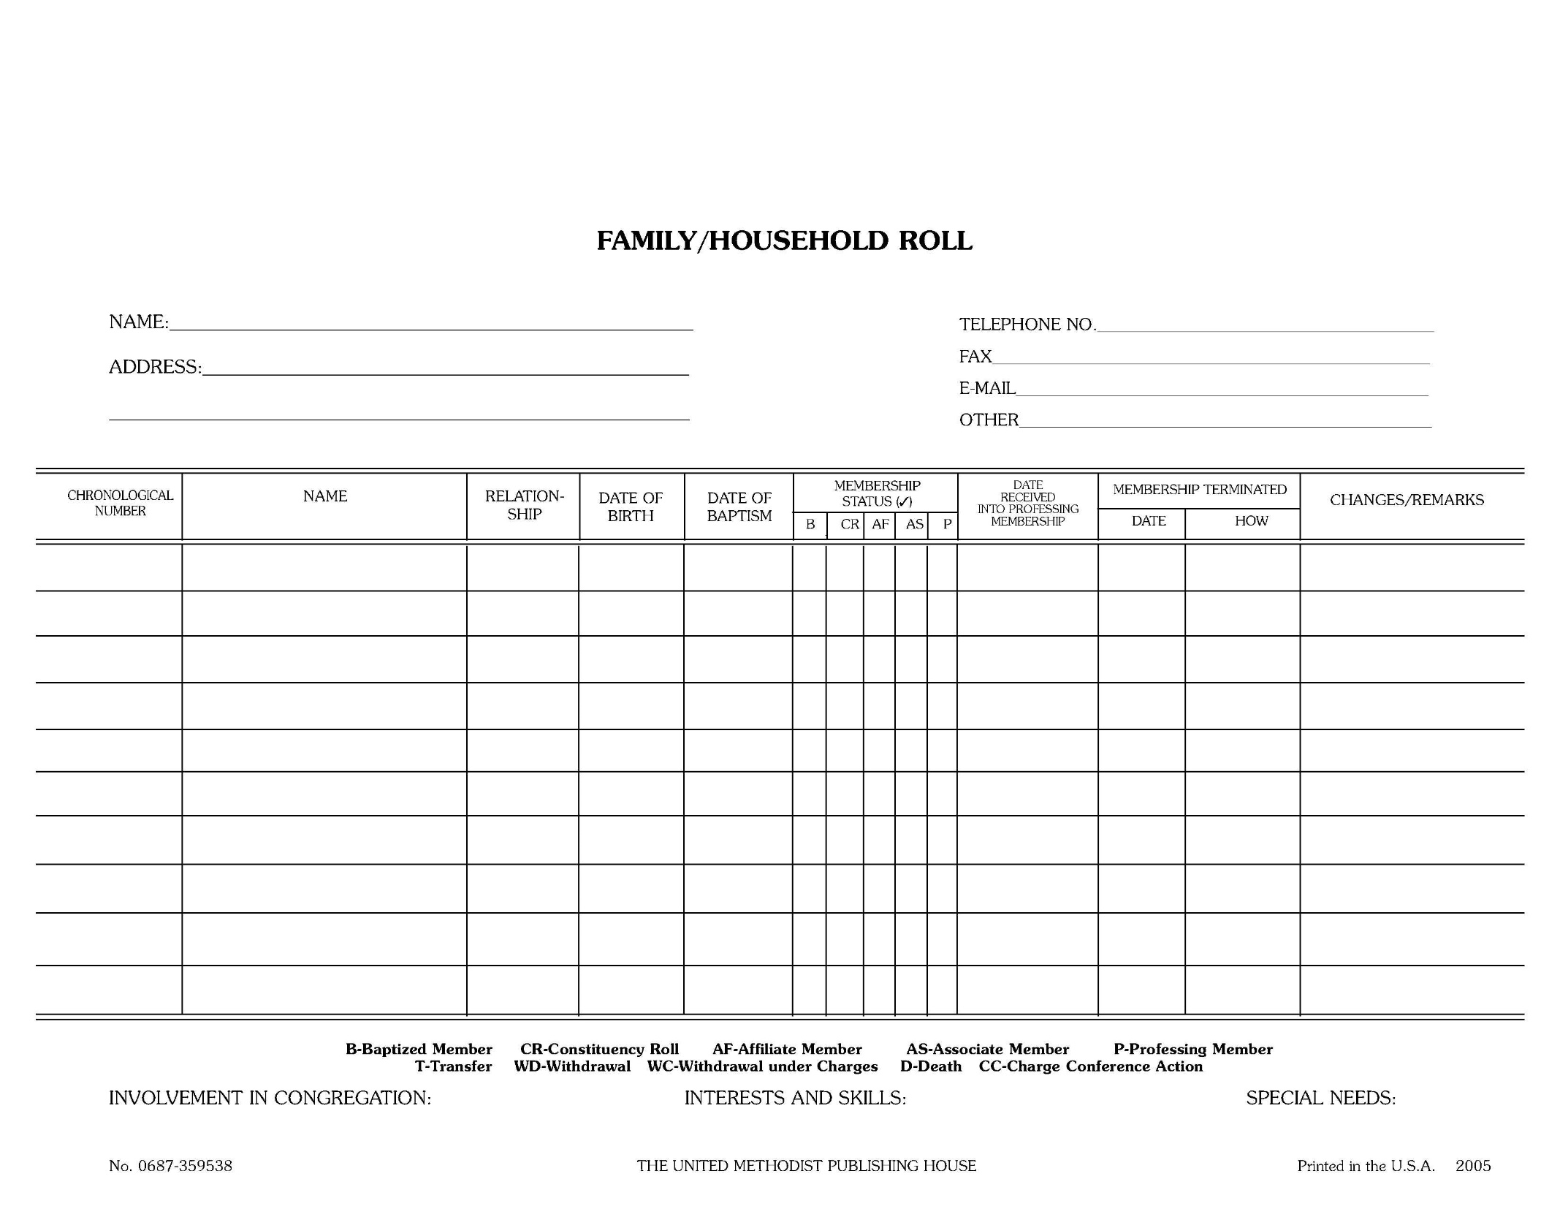

Slide 20
Membership
Making the Transfer
  Requesting a transfer
  Responding to a request for transfer

Slide 21
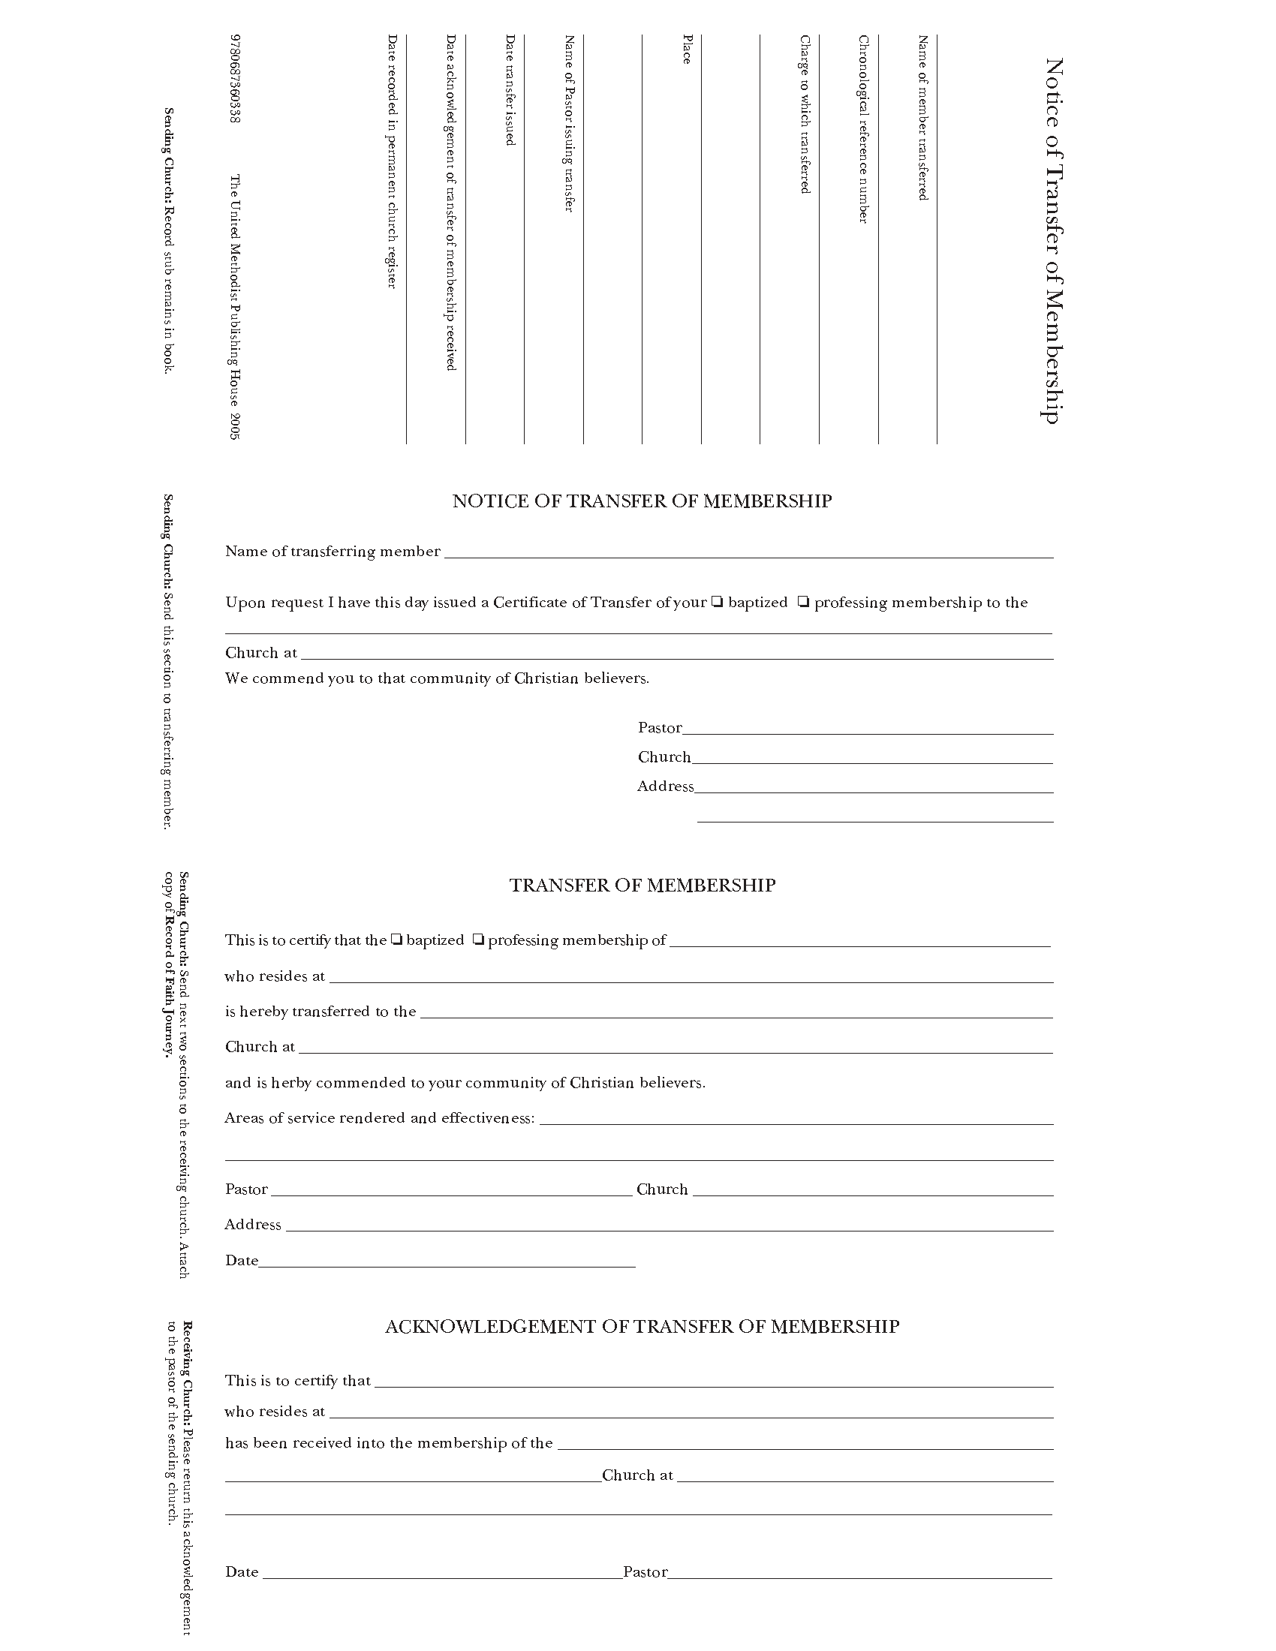
Membership

Slide 22
Membership
Reporting to Charge Conference
  Listing names and dates – Charge Conference Date to Charge Conference Date
Reporting to Annual Conference
  Table I – numbers only – Calendar Year

Slide 23
Finance Committee
Membership and Duties

Slide 24
Finance Committee
Chairperson
Pastor
Lay member to annual conference
Chair-Church Council
Chair – SP/PRC
Chair – Trustees
Lay Leader
Financial Secretary
Treasurer

Slide 25
Finance Committee
Stewardship –
Budget
Annual Audit
Report to Church Council
Annual Year-end Statistics

Slide 26


Slide 27
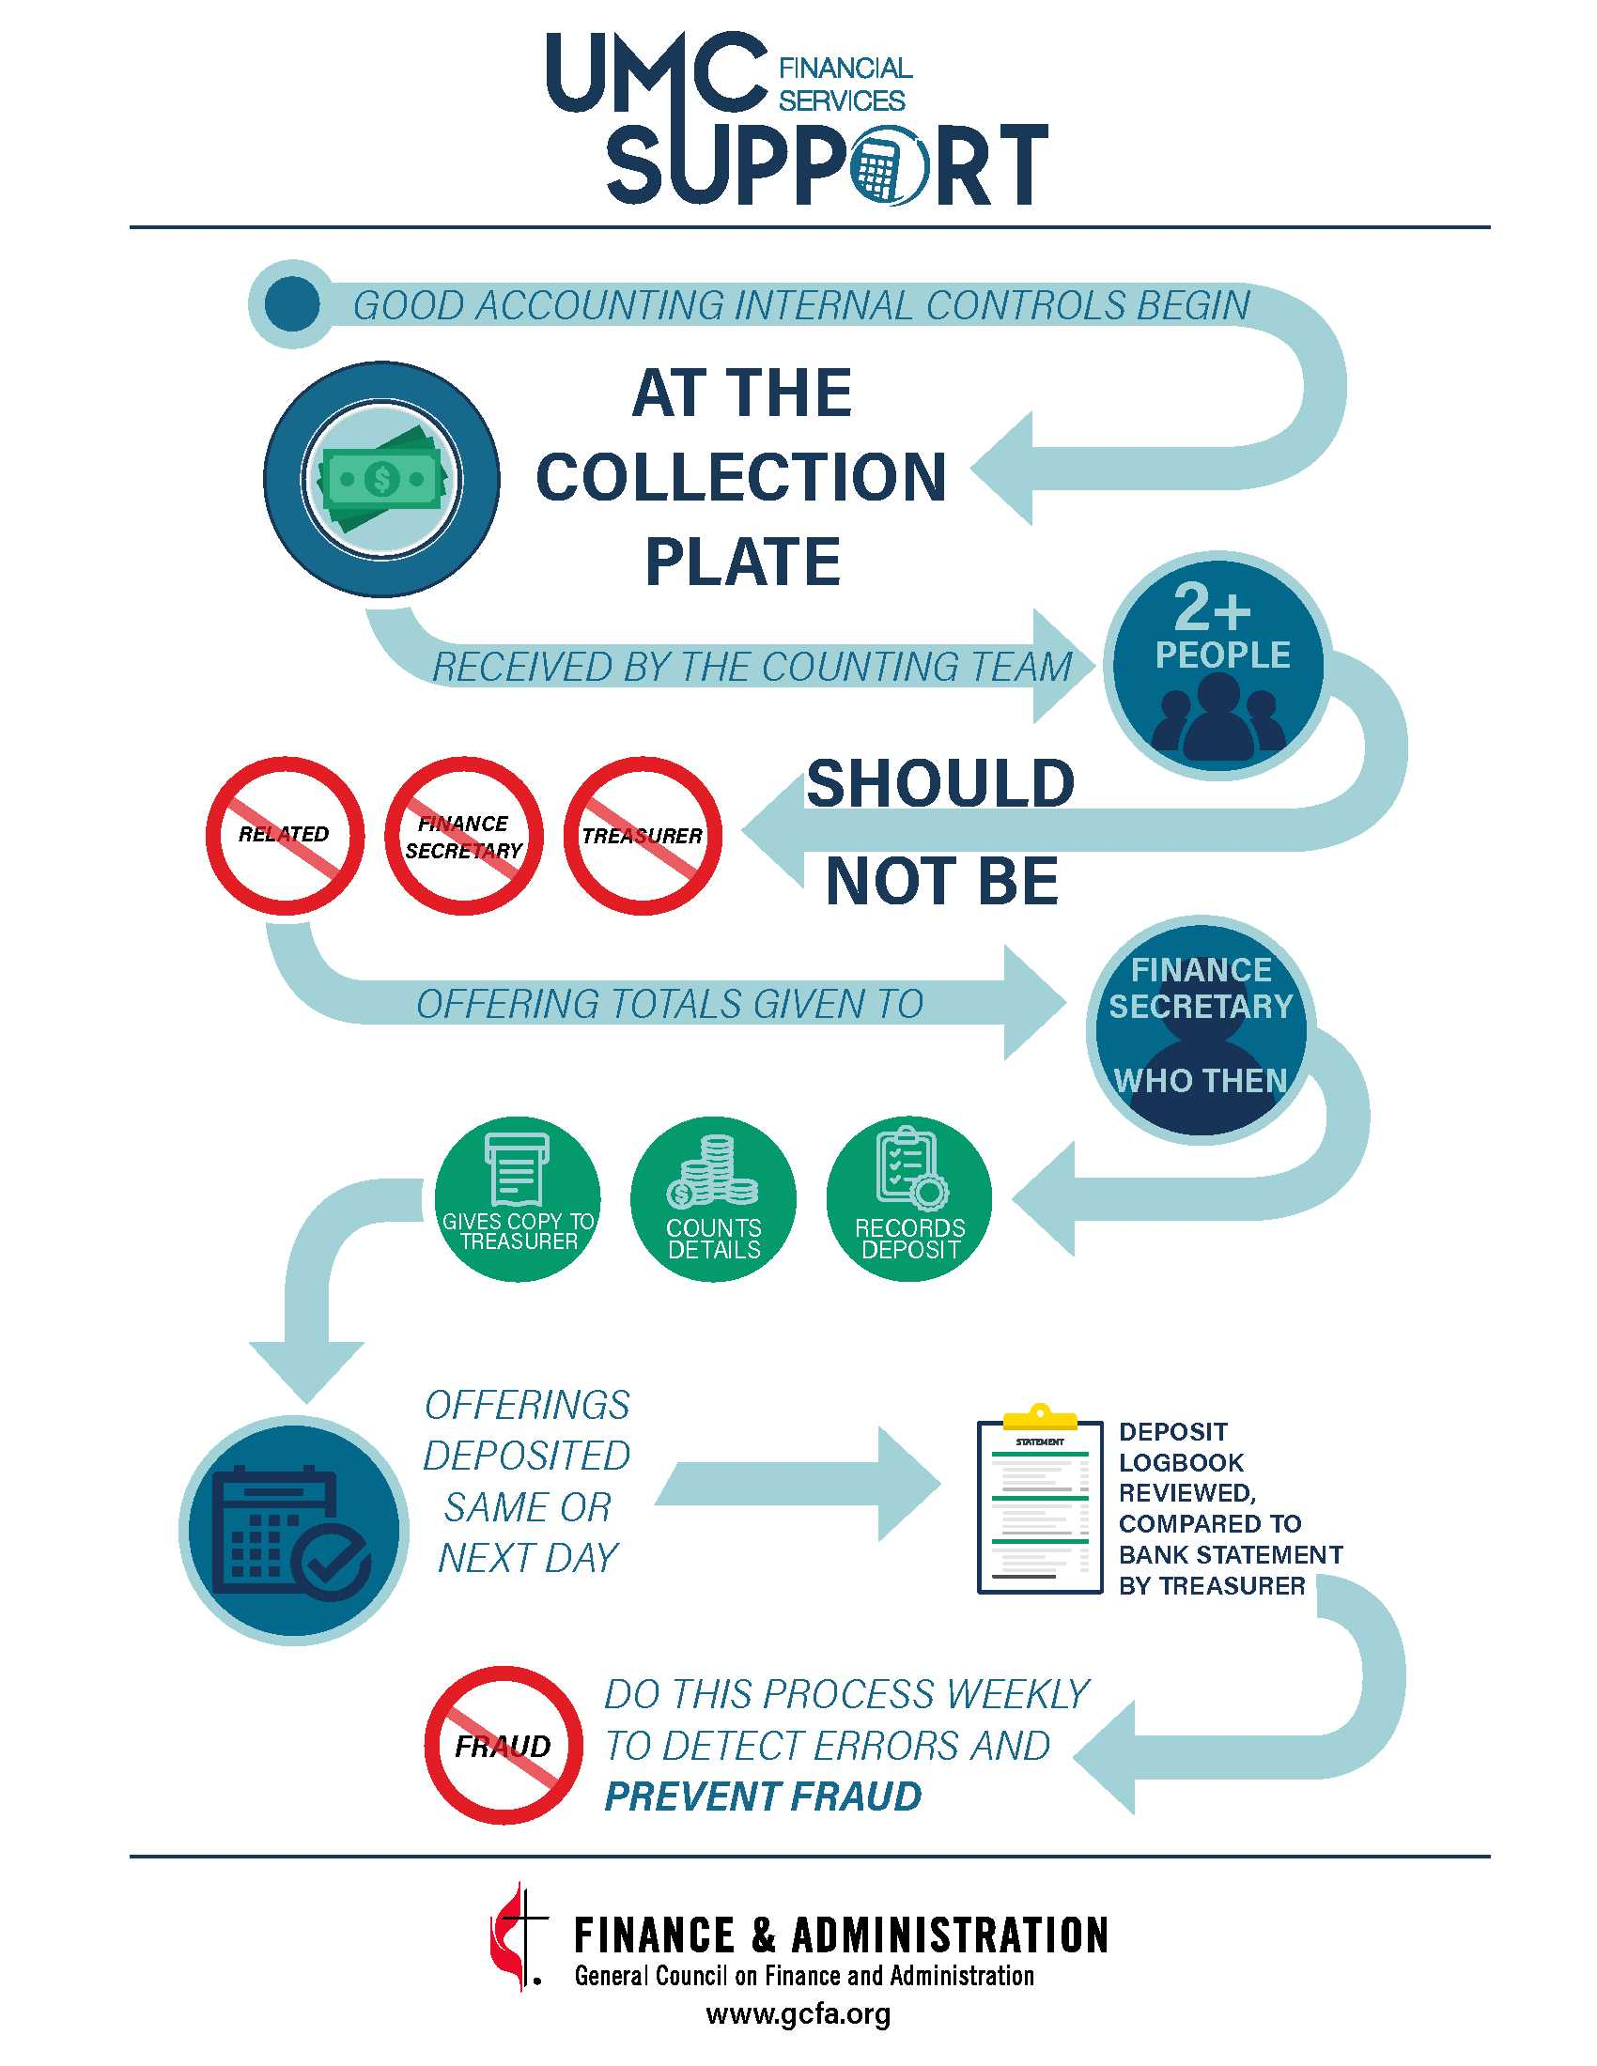
Internal Control Flow Chart
Area 1: Offering / Cash Receipts
Good internal control begins at the collection plate!
After the offering has been taken, it is received by the Counting team, which should consist of two or more persons - unrelated to each other – who are neither the Treasurer nor the Financial Secretary.

Slide 28
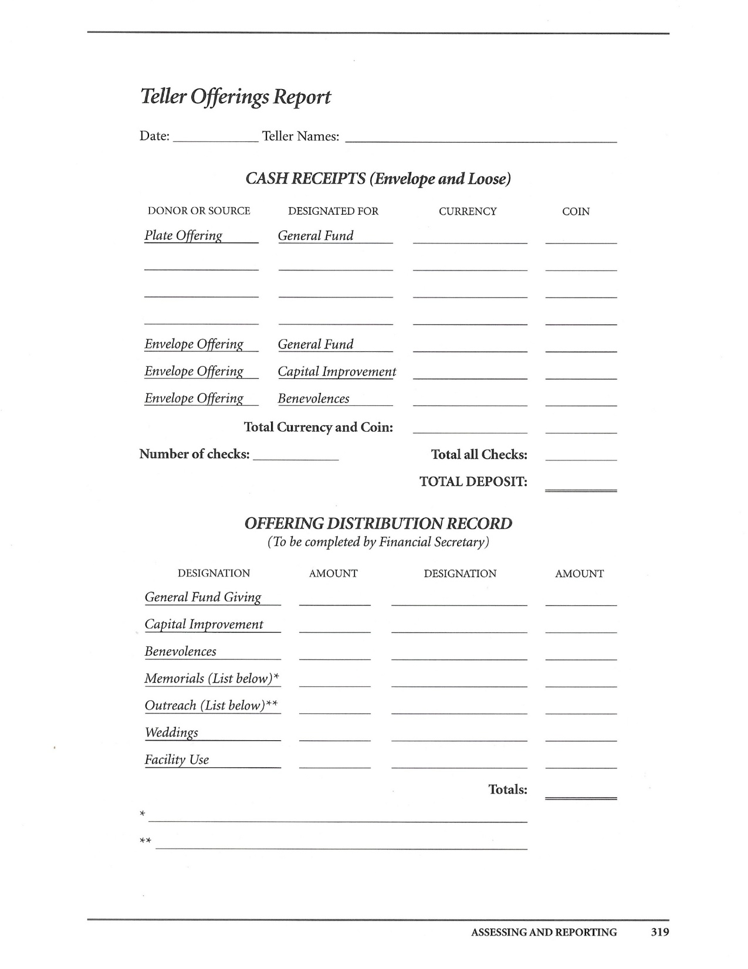

Slide 29
Internal Control Flow Chart
Area 2: Accounts Payable / Disbursements
Accounts Payable is the management of monies being disbursed.
To prevent and detect fraud, vendors and suppliers need to be set up by someone other than the person entering
invoices and/or cutting checks.
Invoices must be required for all payments and approved by someone other than the Financial Secretary or
Treasurer. This person should be authorized by the church’s Finance Committee.
Checks are cut only after invoices are properly approved and authorized.
Requiring two signatures and/or reviews of all checks also improves internal controls.

Slide 30
Internal Control Flow Chart
Area 3: Account Reconciliation
Account Reconciliation is a period-end review of all credits and debits. It is an important process for maintaining
financial integrity, ensuring accuracy, and that spending is aligned to the mission and budget.
All balance sheet accounts and reconciliations need to be reconciled at least monthly by someone other than the preparer.
Bank accounts ideally would be reconciled at least weekly after deposits are made.
Someone other than the treasurer or the financial secretary should review bank reconciliations quarterly or at least bi-annually.

Slide 31
Segregation of Duties is a MUST!
Segregation of Duties is the most critical control! It helps to achieve all five goals of good internal control. Here are a few tips to effectively segregate duties:
The Counting Team cannot be related to or part of a household with each other, the Treasurer, or the Financial Secretary.
The Treasurer and Financial Secretary must also not be related to or part of the same household.
Those who approve invoices ought to be Persons designated by the Finance Committee, and invoices should not come from the Treasurer or Financial Secretary.
New Supplier creation needs to be from someone other than the person entering invoices.
Bank reconciliations should be prepared by the Financial Secretary and reviewed by the Treasurer. A 3rd party designated by the Finance Committee ought to review them quarterly.

Slide 32
Giving
IRS Requirements
  Written communication of gifts
  Differentiation between gifts and payment for services
  Listing of individual gifts of $250 or more.

Slide 33
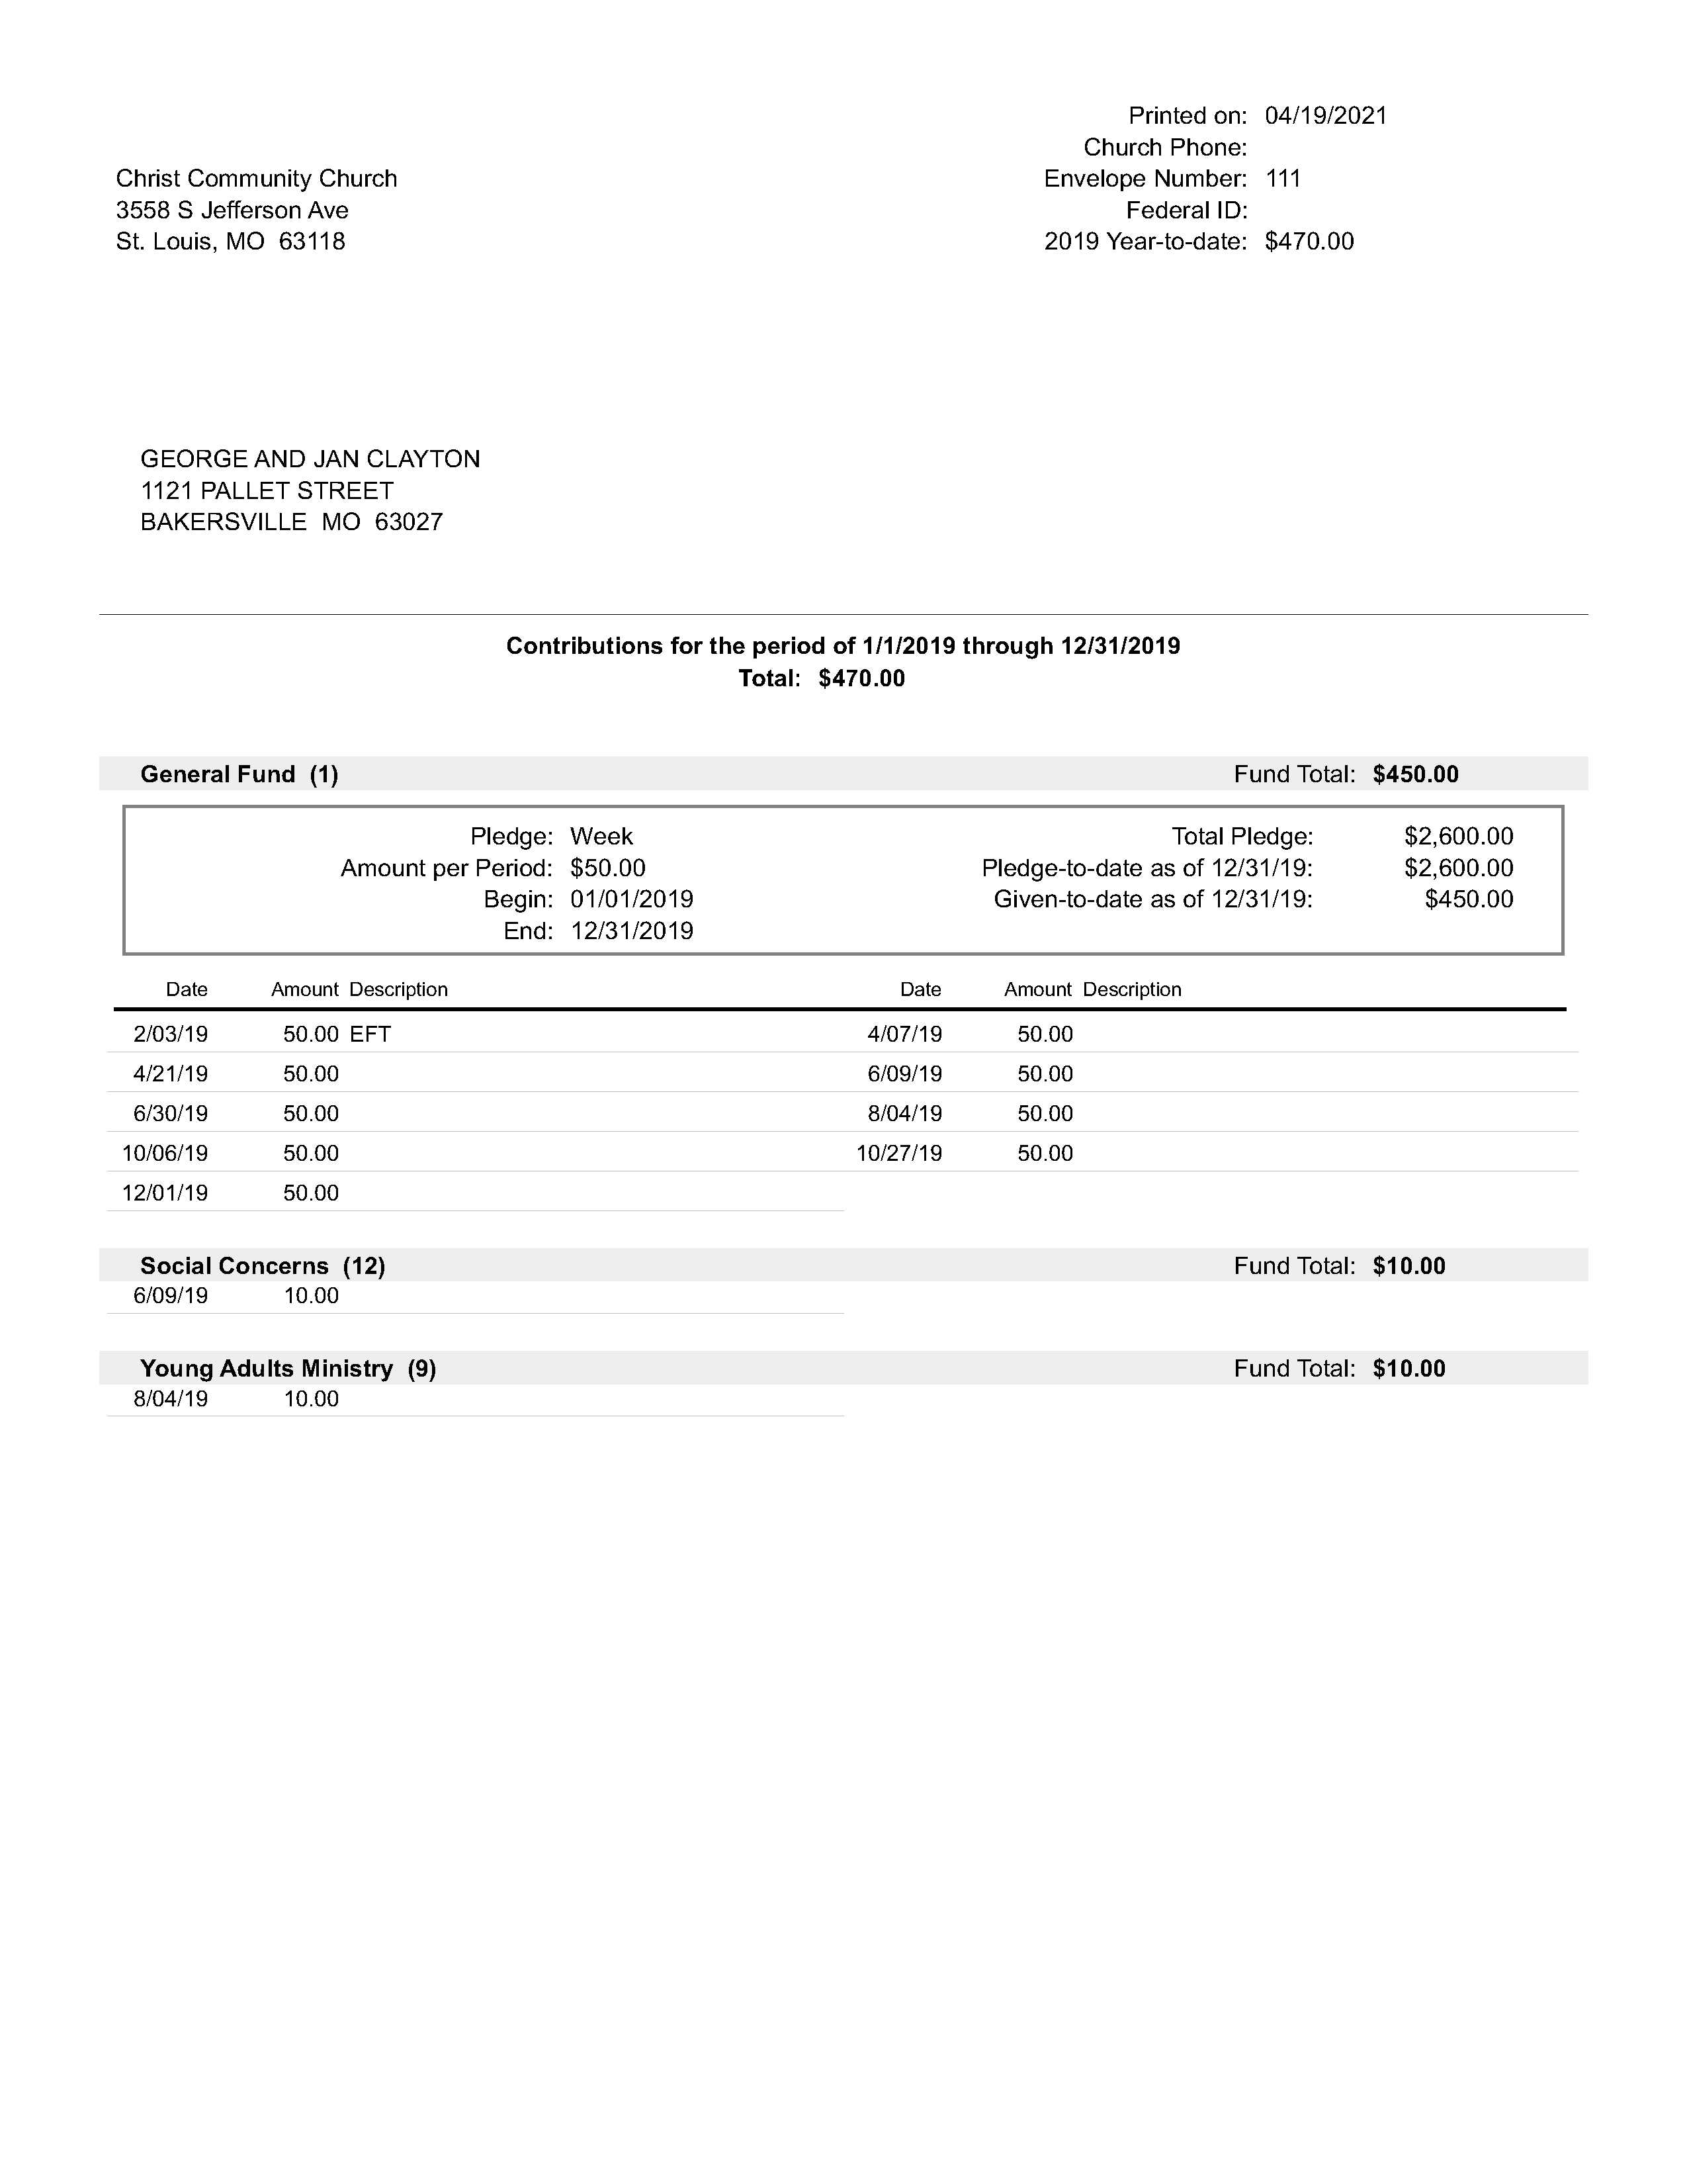

Slide 34
Giving
Reporting to Councils and Boards
  Monthly Giving Statement
    Giving per Fund
    Giving per Giving Unit
Reporting to Annual Conference
  Table III

Slide 35
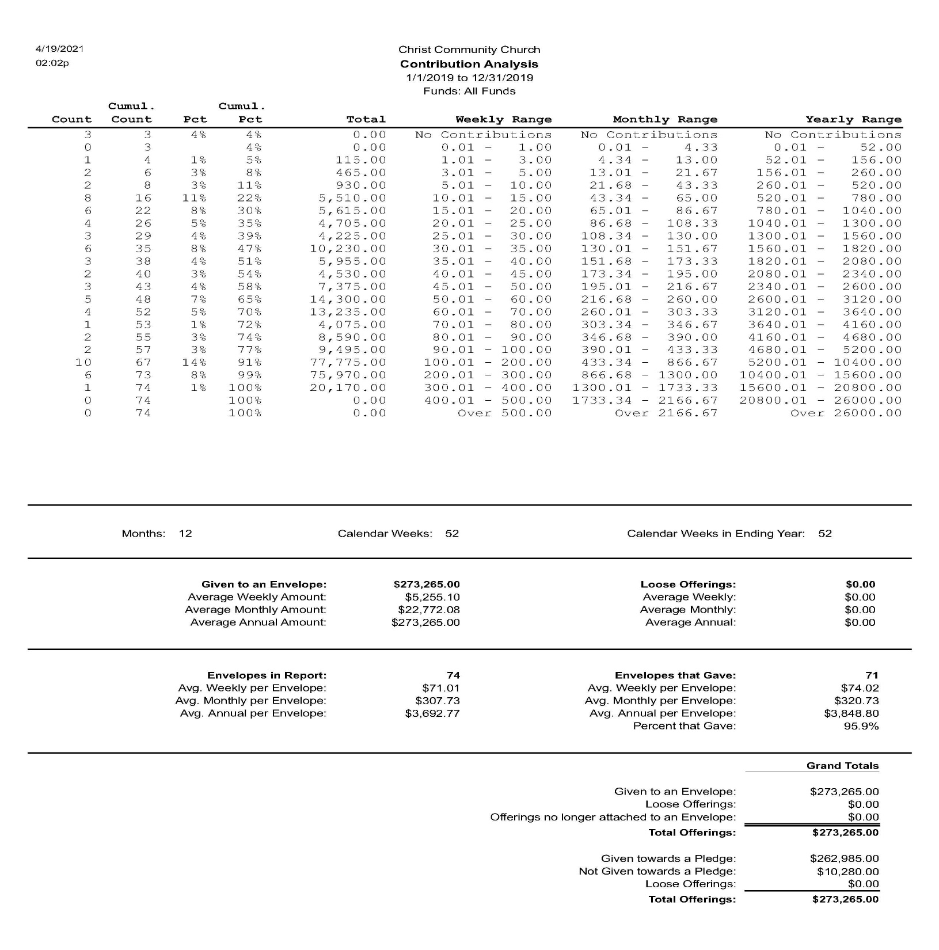

Slide 36
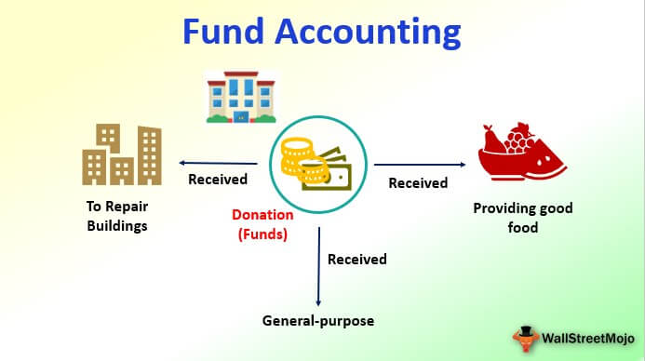

Slide 37
Financial
Concept of Fund Accounting
  Unrestricted Funds
    General Fund
    Undesignated Memorials

Slide 38
Financial
Fund Accounting
  Temporarily Restricted Funds
    Capital Fund
    UMC Missions
    Local Missions
    Designated Memorials
    Special Projects funds

Slide 39
Financial
Fund Accounting
  Permanently Restricted Funds
    Endowments
    Bequests

Slide 40
Financial
Reporting to Councils and Boards
  Statement of Income and Expense
  Budget Comparison
  Statement of Cash Balances
    Amount unrestricted
    Amount temporarily restricted
    Amount permanently restricted

Slide 41
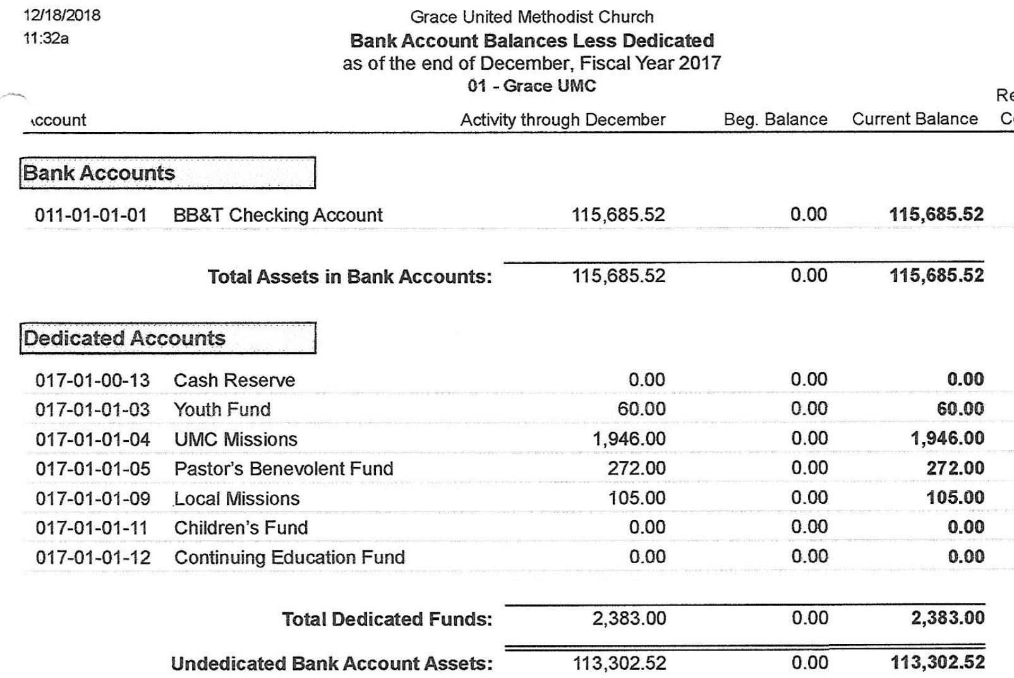

Slide 42
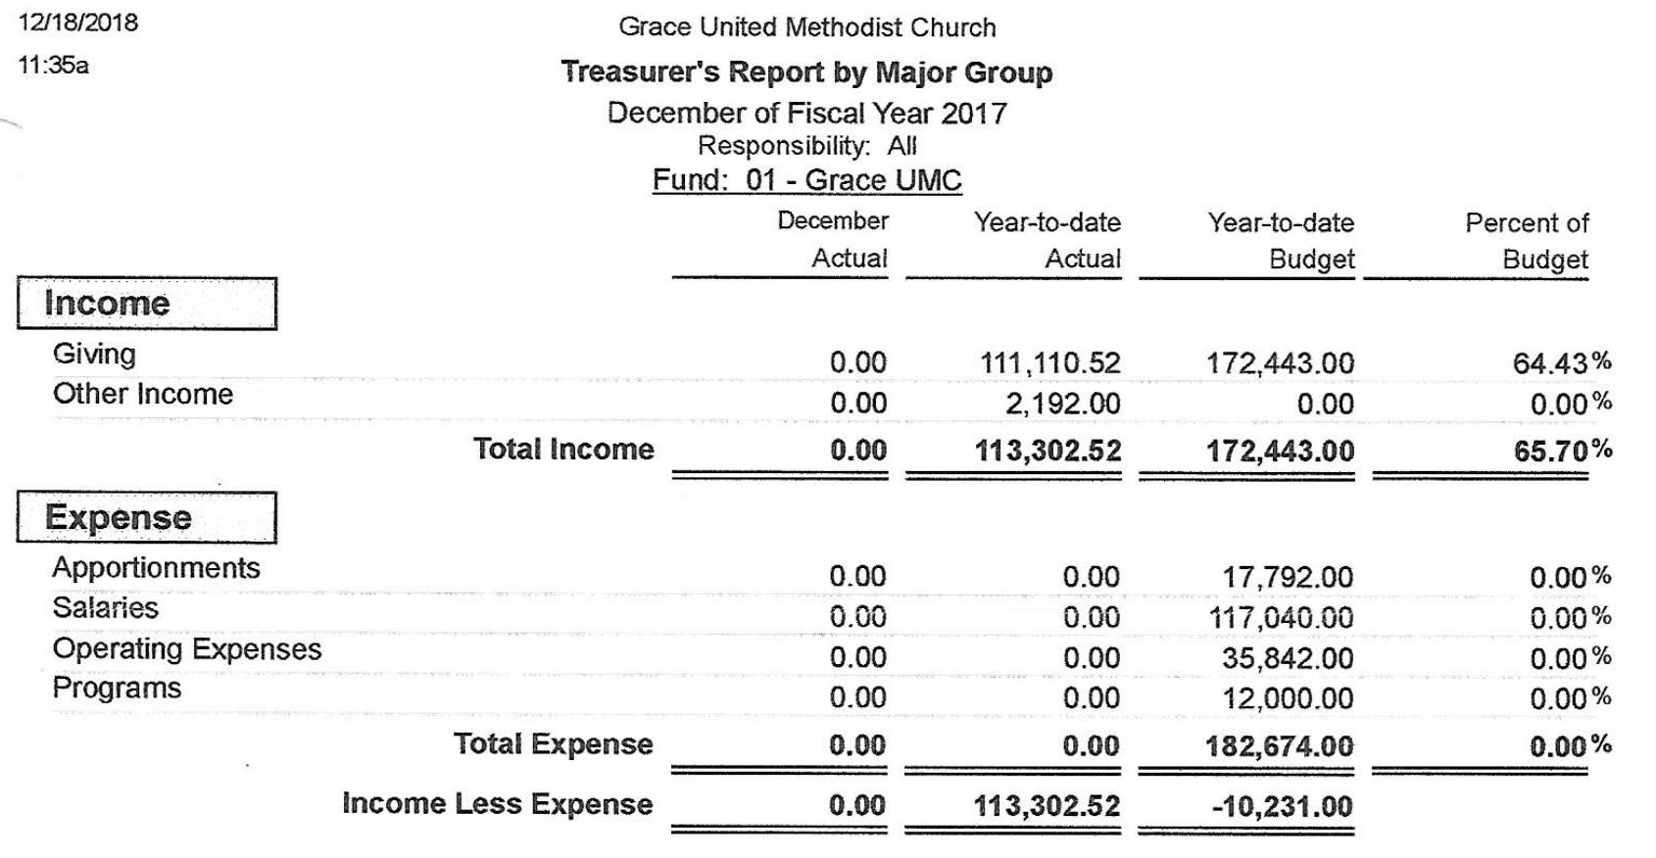

Slide 43
Financial
Reporting to Charge Conference
  Annual Audit
  Report of the Finance Committee

Slide 44
Financial
Reporting to Annual Conference
  Table II
  Table III
  Annual Audit

Slide 45
Local Church Audit Guide Packet
Local Church Audit Guide Recommended Procedures Appendix A
Local Church Audit Guide Internal Control Checklist Appendix B
Local Church Audit Guide 2021
Local Church Audit Guide FAQs

Slide 46
Personnel
Staff/Pastor Parish Relations Committee

Slide 47
Personnel
UMC Requirements
Government Requirements

Slide 48
Personnel
Government Requirements
  IRS
  Congress
  INS (Homeland Security)
  State of South Carolina
  United Methodist Church

Slide 49
Personnel
Government
  IRS
    Who qualifies as an independent contractor
      20 questions – No set answers.
    All others are employees
    Must withhold Social Security and Medicare (FICA)
    May withhold Income Tax withholding
    Form W-4, gets form W-2, not 1099

Slide 50
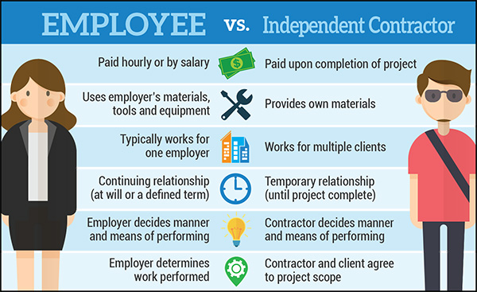

Slide 51
Personnel
INS (Homeland Security)
  The Immigration Reform and Control Act of 1986 (IRCA) required employers to verify that all newly-hired employees present "facially valid" documentation verifying the employee's identity and legal authorization to accept employment in the United States
  Must complete Form I-9 for each employee
  Must have on file at all times

Slide 52
Personnel
South Carolina State Requirements
  E-Verify – effective 1/1/2012 – Relates to Alien Employment
    https://www.llr.sc.gov/Immigration/index.asp?file=E-verify.htm
  New Hire Reporting – Relates to Child Services and Child Support.
    https://newhire.sc.gov/

Slide 53
Federal and State Posters
Federal Work-Place Posters
  https://www.dol.gov/general/topics/posters
State Work-Place Posters
  https://www.llr.sc.gov/aboutus/index.asp?file=Posters.htm

Slide 54
Personnel
United Methodist Requirements
  Background Check – People Facts (formerly Trak-1)
    https://peoplefacts.com/

Slide 55
Personnel
Congress
  IRS Publication 517
    Clergy are employees for Income Tax Purpose
    Clergy are self-employed for Social Security Purposes
    Churches are not required to withhold
    Pastor may request withholding
    Clergy file quarterly estimates
    Gets form W-2, not 1099

Slide 56
Personnel
Recommended Documents
  Job Description
  Application
  Reference Check
  Consent for Background Check
  Background Check
  Annual Evaluation and Goals and Objectives
  Termination Interview

Slide 57
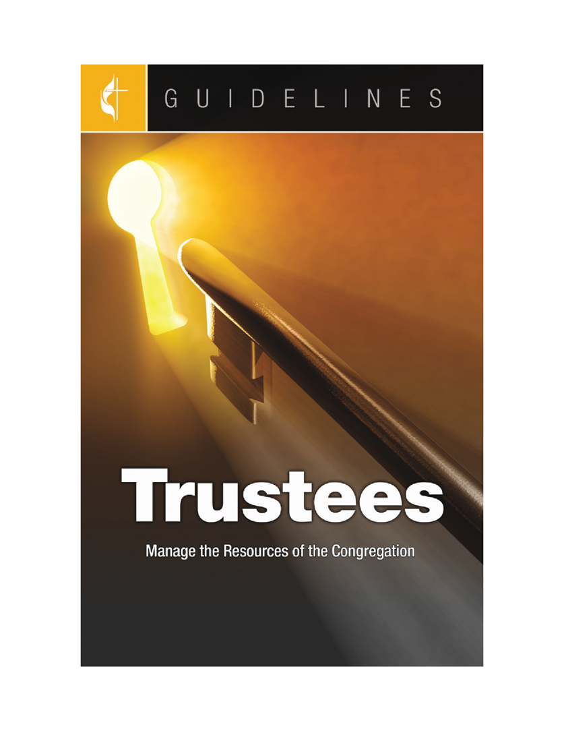
Board of Trustees
Keeping Legal Documents

Slide 58
Legal
Local Church Incorporation
  Protects members, trustees and officers from individual lawsuits
  Required by Annual Conference
  Paragraph 2506 of Discipline lists requirements
  Update incorporation regularly
  Update deeds with new incorporation name

Slide 59
Church Incorporation
Did you know the Book of Discipline has several paragraphs regarding the incorporation of a local church? There are several good reasons for incorporation, including protecting and exempting individual officers and members of local church from legal liability. GCFA’s legal team has written a handy guide to walk you through incorporating your local church, including a checklist and sample resolutions and articles.
Download Today for Your Ministry
https://sos.sc.gov/online-filings/business-entities

Slide 60
Legal
Trust Clause
  Discipline paragraphs 2501, 2502, 2503
  All church property and parsonages owned by local entity but held in trust for the denomination.
  All deeds must have a trust clause – see paragraph 2503

Slide 61
Understanding the UMC Trust Clause
The United Methodist Church is in transition. At the 2020 General Conference there will be discussions about several proposals for the restructuring, separation, or dissolution of the United Methodist Church. These proposals have brought concerns about property, assets, and the trust clause to the forefront of discussions. We want to help United Methodists across the connection stay informed and have a full understanding of our current policies as they pray and prepare for GC 2020. https://www.gcfa.org/resource/understanding-the-umc-trust-clause

Slide 62
Legal
Insurance
  Minimum Requirements from GCF&A
  https://www.umcsc.org/trustees/
  Property
  Liability
  Safe Sanctuary and sexual misconduct
  Director’s Insurance
  Discrimination & Employment Practices
  Bonding of persons who handle cash
  Worker’s Compensation Insurance

Slide 63

Legal
https://www.umcsc.org/safe-sanctuaries/

Slide 64





Legal – Safe Sanctuaries

Slide 65
Legal
Child Abuse Protection
  Safe Sanctuary Policy
  Requirements
    How to Prevent Abuse
    How to Report Abuse
    How to Care for All Involved
  Reporting
  Include copy in Charge Conference Reports

Slide 66
Legal
Dealing with COVID-19 and Safety Protocols
https://www.umcsc.org/bestpractices/
CDC Guidelines
No Insurance Coverage Available

Slide 67
Dealing with COVID-19
Social Distancing
Individuals or households stay 6 feet apart.
Masks & Glasses
Masks should cover mouth and nose.
Consider eye coverings.
Small Numbers
Safer than large numbers of people.
No Singing
Of any kind – choir, soloist, congregation.
No Shared Meals
Distribute box meals for take-home.
Communion
Use single-serve elements.
Maintain 6-foot social distancing at all times.
Vaccines
Strongly encouraged, when available.
Spacing
No more than one person per 36 square feet.
Air
Outside is safer than inside.
If indoors, use best filtering possible.
Short Gatherings
Safer than long gatherings.
Hand Sanitizer
Provided at all gatherings.
Hand Washing
Continually encouraged.
Restrooms
Use only for emergencies.
Confined space + poor ventilation = unsafe.
Flu Shots

Slide 68
Resources
CDC Guidelines for Churches
  https://www.cdc.gov/coronavirus/2019-ncov/community/faith-based.html
  What if Someone Tests Positive?
  https://www.umcsc.org/home/wp-content/uploads/RRR-Best-Practices-Responding-After-Attendee-Reports-Positive-COVID-Test.pdf

Slide 69
Facility Use Guidelines
Use must be consistent with UMC Social Principles
Written Use Agreement
  Must have own insurance – put church on additional insured
  Must follow Safe Sanctuaries Guidelines
  Must follow CDC COVID Guidelines
  Trustees Forms – Basic Church Administration (church-admin.org)

Slide 70
Facilities Guidelines
Charge Conference Needed for:
  Authority to purchase or build
  Authority to transfer or sell
  Authority to create credit line or refinance mortgage
  Pastor, DS, District committee on Church Building and Location
  Accept and set guidance to trustees on Endowments and Bequests

Slide 71
Facilities Use Guidelines
Coordinate with Health & Welfare
  Annual accessibility audit
    What are the issues?
    How do we plan to address the issues?

Slide 72
Your Presenter
Rev. Robert L. Cox, Retired
rlcox@umcsc.org
864-554-2008
www.church-admin.org

